Slide 1
HYBRIS: Validation week 8
Task 8.4 - (Validation):
Task: Add "age" attribute to the "Customer" type.
Create validation to check user age. Make it impossible to create aCustomer with age < 18.

Slide 2
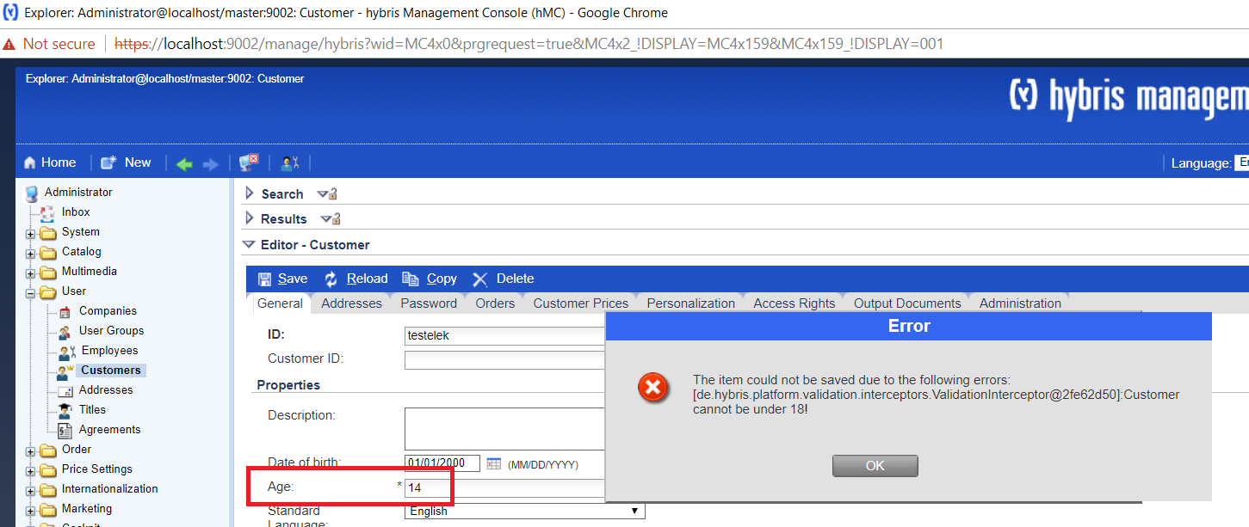
Here are the steps that I took to set up the desired validation: - Added the age attribute to Customer item type. - Created an attribute validation item type called NotUnderAgeConstraint - Implemented a constraint validator called NotUnderAgeValidator - Inserted a constraint to the database with impex - Added the age attribute to hmc.xml
Implementation details

